Slide 1
Data Analytics for Predicting Movie Success
Mike Claussen

Slide 2
Outline
Project Description
Background/Data Visualization
Analysis of Models
Regression
Classification
Clustering
Suggestions and Implications

Slide 3

Project Description
Given data for roughly 4000 movies the goal is to determine what aspects of a movie impact success.
Using IMDb score to put a numerical value to a movie’s success.

Slide 4

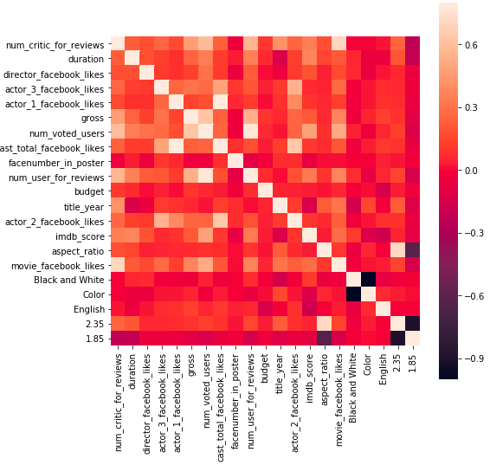
Background/Data Description
3756 movies
Correlation analysis
Negative Correlation: Facenumber_in_poster, title_year, color, English
Positive Correlation: duration, num_voted_users, movie_facebook_likes

Slide 5
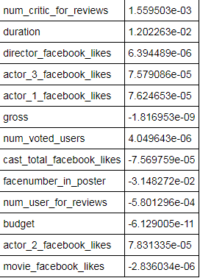
Regression Analysis
Linear Regression Model
MSE: .744
R-Squared: 0.33
Random Forest Regressor
MSE: 0.10
R-Squared: 0.91

Slide 6
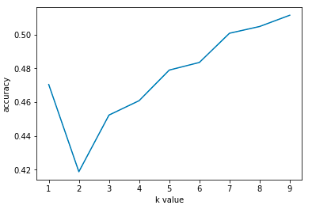

Classification Analysis: KNN
Optimal k value: 10
Accuracy: 0.62
Confusion Matrix:

Slide 7

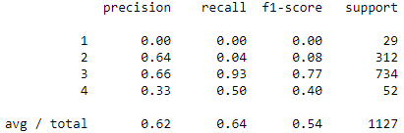
Classification Analysis: Logistic Regression
Accuracy: 0.64
Confusion Matrix and metrics:

Slide 8

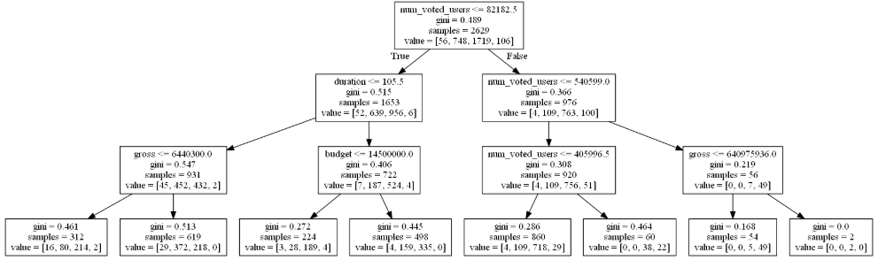
Classification Analysis: Decision Tree
Accuracy: 0.70
Confusion Matrix:

Slide 9
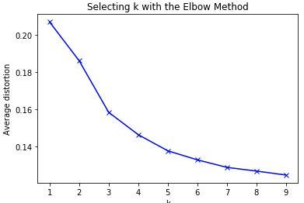
Clustering Analysis
Optimal number of clusters: elbow method
Cluster profiles
Cluster 0: shortest duration, lowest average facebook likes for actors and directors, low gross earnings, and low budget
Cluster 1: short duration, next lowest average likes, lowest gross earnings, and low budget
Cluster 2: longer duration, mid level of likes, mid level gross earnings, and mid level budget
Cluster 3: short duration, mid level of likes, low gross earnings, mid level budget
Cluster 4: long duration, highest number of likes, highest gross earnings, highest budget

Slide 10
Suggestions and Implications
Traits of excellent movie:
Few faces on poster
High number of likes on facebook
Director
Actors
Movie
Longer duration

